Slide 2
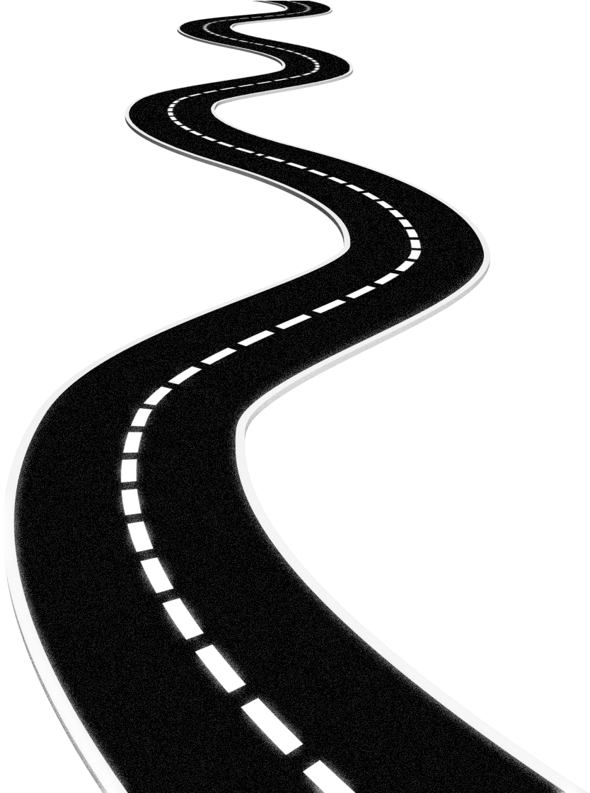
The Road Not TAKEN
By ;- Robert Frost

Slide 3
Synopsis
Driven by our hopes and ambitions, we take a decision taken by fewer people. We think that if fail to seek accomplishments we could get a chance to change and start again. However, we travel too far and have to regret it in the end. Also, it is possible that we could become extraordinary people because of that one decision.

Slide 4
TABLE OF CONTENTS
01
02
03
04
Explanation
Poetic Devices
Difficult Words
Questions

Slide 5
Two roads diverged in a yellow wood, And sorry I could not travel both And be one traveler, long I stood And looked down one as far as I could To where it bent in the undergrowth;

Slide 6
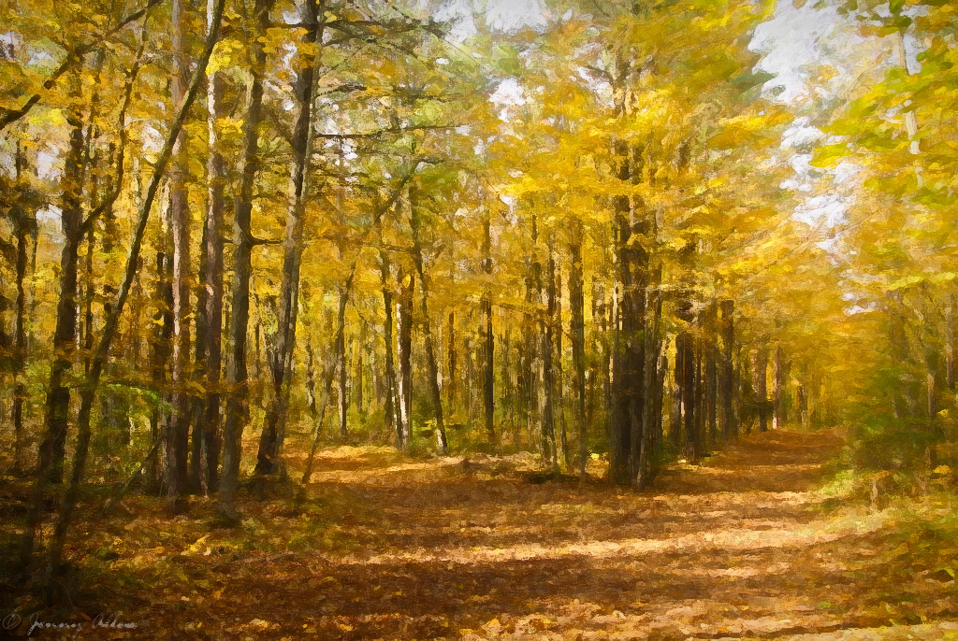
This stanza presents the main situation the poet’s faces. The context is of “a yellow wood” where the poet feels sorry that there are two roads and he has a choice to travel on one of them. The reason is he is a single person and not a double.
Therefore, he needs to travel only once after looking at one of them that it is less traveled and that it shows undergrowth which means very few people have traveled through it. The stanza contributes to the main idea of choice in one’s life by presenting two roads, their contexts, and situations.

Slide 7
Poetic Devices:
Anaphora
Symbolism
Repetition of 'And' at the beginning of lines 2, 3, and 4.
The road is a representation for the journey or the life choice that the poet makes.

Slide 8
Poetic Devices:
Enjambment
Metaphor
Lines 3, 4, and 5 have a continuous flow with any punctuation mark.
The word undergrowth stands for the future into which the poet cannot see.
The road is a metaphor for the choices we make in life.

Slide 9
Difficult Words:
Diverged
Undergrowth
separated and took a different direction
dense growth of plants and bushes means the forest
Yellow Wood
a forest with decomposing leaves

Slide 10
Then took the other, as just as fair, And having perhaps the better claim, Because it was grassy and wanted wear; Though as for that the passing there Had worn them really about the same,

Slide 11
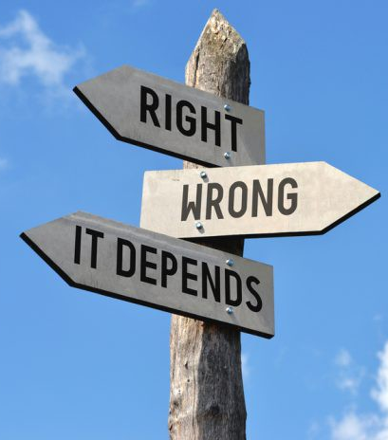
The speaker takes the other path, judging it to be just as good a choice as the first, and supposing that it may even be the better option of the two, since it is grassy and looks less worn than the other path.
Though, now that the speaker has actually walked on the second road, he or she thinks that in reality the two roads must have been more or less equally worn-in.

Slide 12
Poetic Devices:
Simile
Alliteration
Both the roads have been compared to each other using the words 'as just as fair'
Repetition of 'd' sound in 'then' and 'the’.
Repetition of 'w' sound in 'wanted' and 'wear'.

Slide 13
Poetic Devices:
Imagery
Personification
The poet gives us a visual description of the two roads. He says that one was grassy as there were hardly any travelers walking down that road.
The road here is personified as wanting humans to travel down its path.

Slide 14
Difficult Words:
Better Claim
Preferable
OR
Better Choice
Wanted Wear
the road had been worn badly

Slide 15
Thank You
By:-
Suprito Ghosh

